Slide 1


<Name>
<Date>

Slide 2

Outline
Executive Summary
Introduction
Methodology
Results
Conclusion
Appendix

Slide 3
Executive Summary
Summary of methodologies
Summary of all results

Slide 4
Introduction
Project background and context
Problems you want to find answers

Slide 5


Slide 6
Methodology
Executive Summary
Data collection methodology:
Data was collected by web scraping
Perform data wrangling
Describe how data was processed
Perform exploratory data analysis (EDA) using visualization and SQL
Perform interactive visual analytics using Folium and Plotly Dash
Perform predictive analysis using classification models
How to build, tune, evaluate classification models

Slide 7
Data Collection
Describe how data sets were collected.
You need to present your data collection process use key phrases and flowcharts

Slide 8
Data Collection – SpaceX API
Present your data collection with SpaceX REST calls using key phrases and flowcharts
Add the GitHub URL of the completed SpaceX API calls notebook (must include completed code cell and outcome cell), as an external reference and peer-review purpose
Use
SpaceX
REST API
API returns
SpaceX
Data in JSON
Normalize
data into
Flat data file
Such as .csv

Slide 9
Data Collection - Scraping
Present your web scraping process using key phrases and flowcharts
Add the GitHub URL of the completed web scraping notebook, as an external reference and peer-review purpose
Get HTML
Response from
Wikipedia
Extract data
using beautiful
soup
Normalize data
into flat data

Slide 10
Data Wrangling
Describe how data were processed
After collecting data, cleaning data is crucial by knowing the sum of null and accordingly replacing suitable values
You need to present your data wrangling process using key phrases and flowcharts
-the GitHub URL
https://jp-tok.dataplatform.cloud.ibm.com/analytics/notebooks/v2/716d3234-d690-4d83-a269-9bc806bc75e1/view?access_token=648097be797506cea2e6315afd148770cbef1071acf2d1a7386c8166cdcfba51
Finding missing
Values in the
datset
Placing None
In columns that
We don’t use
Dealing with
Missing Values
to replace with
mean

Slide 11
EDA with Data Visualization
Summarize what charts were plotted and why you used those charts:
Scatter, line and bar charts are plotted to know if there are any correlation between both columns and visualized trends
GitHub Link to source code

Slide 12
EDA with SQL
Using bullet point format, summarize the SQL queries you performed
Display the names of the unique launch sites in the space mission
Display 5 records where launch sites begin with the string 'CCA’
Display the total payload mass carried by boosters launched by NASA (CRS)
Display average payload mass carried by booster version F9 v1.1
List the date when the first successful landing outcome in ground pad was acheived.
List the names of the boosters which have success in drone ship and have payload mass greater than 4000 but less than 6000
List the total number of successful and failure mission outcomes
List the names of the booster_versions which have carried the maximum payload mass. Use a subquery
List the failed landing_outcomes in drone ship, their booster versions, and launch site names for in year 2015
Rank the count of landing outcomes (such as Failure (drone ship) or Success (ground pad)) between the date 2010-06-04 and 2017-03-20, in descending order
GitHub Link to source code

Slide 13
Build an Interactive Map with Folium
Interactive map objects are included such as markers, circles, lines, etc. you created and added to a folium map
This things are added to have more clarity, functionality and informative
GitHub Link to source code

Slide 14
Build a Dashboard with Plotly Dash
plots/graphs and interactions have added to a dashboard
This interactions make the it feel alive and dynamic
GitHub Link to source code

Slide 15
Predictive Analysis (Classification)
Summarize how you built, evaluated, improved, and found the best performing classification model
You need present your model development process using key phrases and flowchart
Add the GitHub URL of your completed predictive analysis lab, as an external reference and peer-review purpose
GitHub Link to source code

Slide 16
Results
Exploratory data analysis results
Interactive analytics demo in screenshots
Predictive analysis results

Slide 17


Slide 18
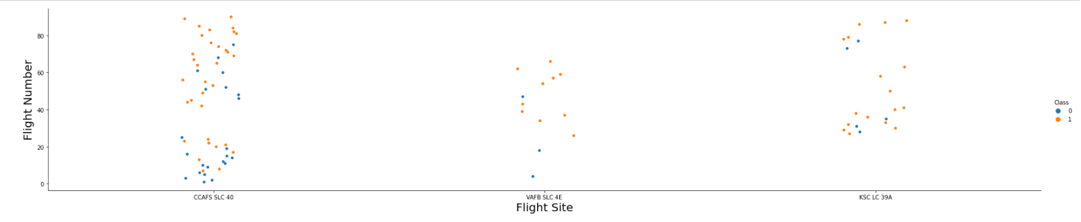
Flight Number vs. Launch Site
Show a scatter plot of Flight Number vs. Launch Site
The higher the flight number for Launch Site CCAFS SLC 40 the higher the success rate for the Rocket.

Slide 19
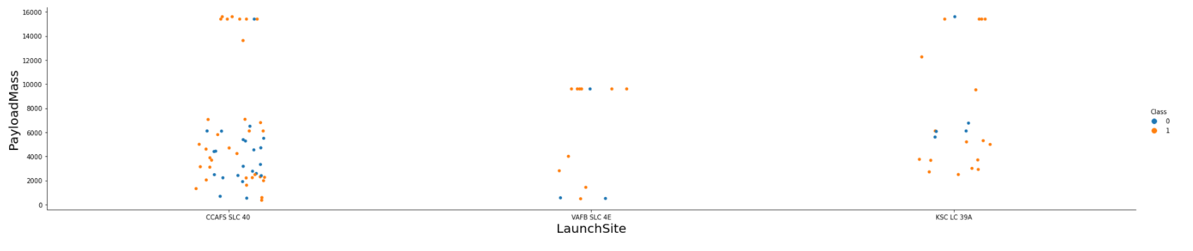
Payload vs. Launch Site
Show a scatter plot of Payload vs. Launch Site
The greater the payload mass for Launch Site CCAFS SLC 40 the higher the success rate for the Rocket.

Slide 20
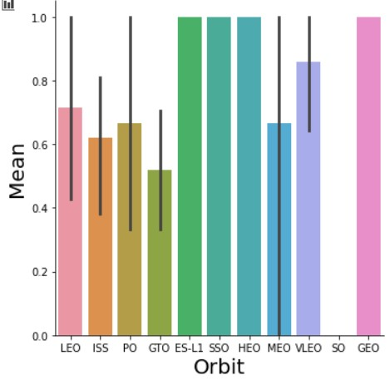
Success Rate vs. Orbit Type
Show a bar chart for the success rate of each orbit type
Orbit GEO,HEO,SSO,ES-L1 have the best Success Rate

Slide 21
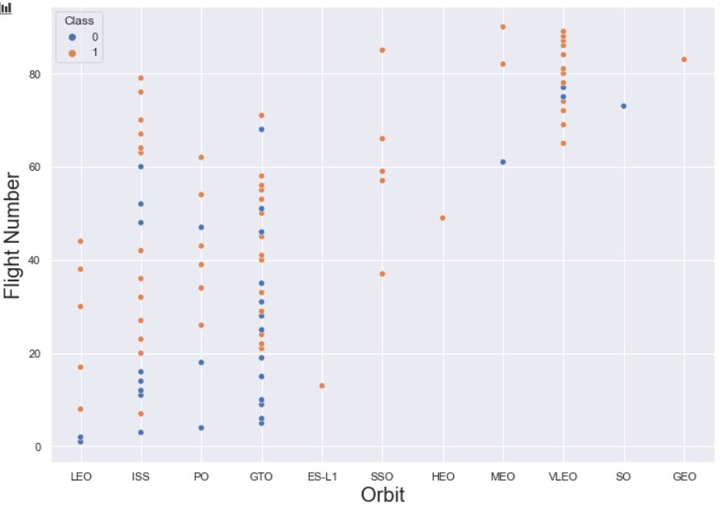
Flight Number vs. Orbit Type
Show a scatter point of Flight number vs. Orbit type
LEO orbit the Success appears related to the number of flights; on the other hand, there seems to be no relationship between flight number when in GTO orbit.

Slide 22
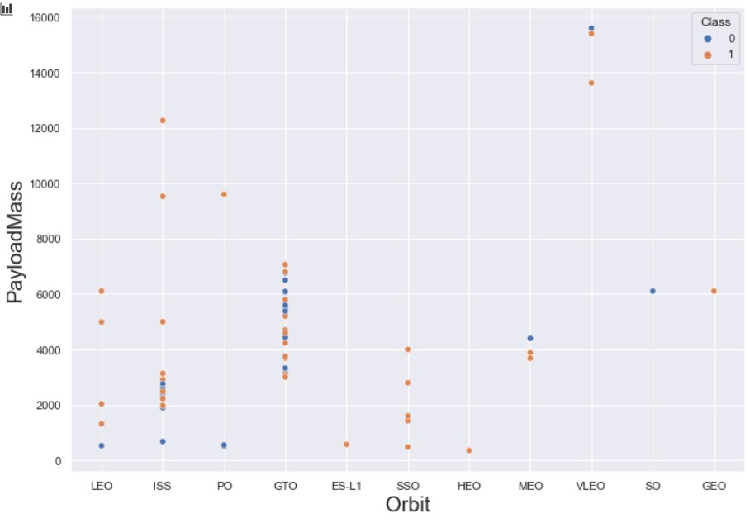
Payload vs. Orbit Type
Show a scatter point of payload vs. orbit type
Heavy payloads have a negative influence on GTO orbits and positive on GTO and Polar LEO (ISS) orbits.

Slide 23
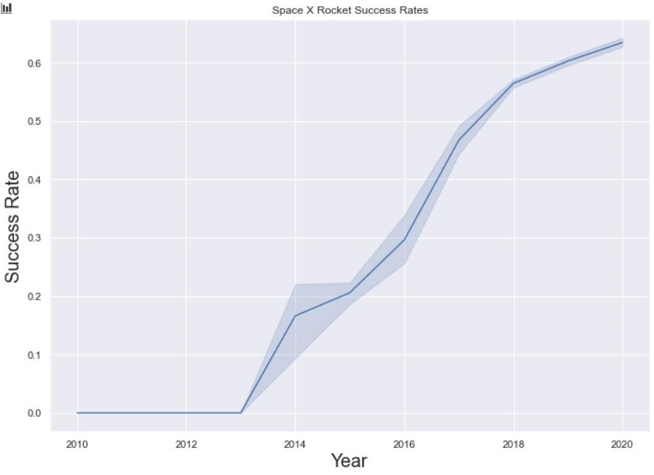
Launch Success Yearly Trend
Show a line chart of yearly average success rate
The trend from 2013 is rising till 2020

Slide 24
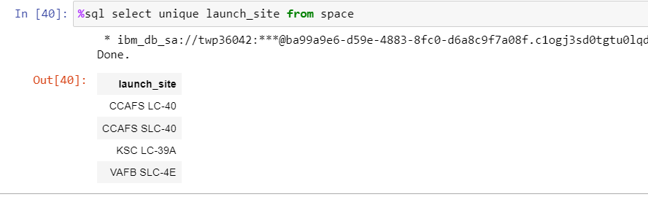
All Launch Site Names
Find the names of the unique launch sites
Present your query result with a short explanation here:
This query indicates with no repetition of launch sites

Slide 25
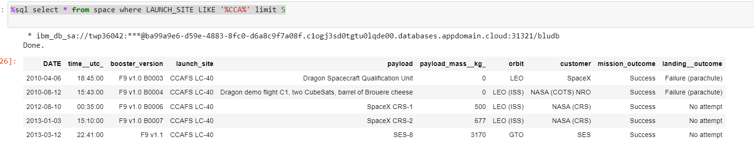
Launch Site Names Begin with 'CCA'
Find 5 records where launch sites begin with `CCA`
Present your query result with a short explanation here
There are 5 records that include CCA in the launch site

Slide 26
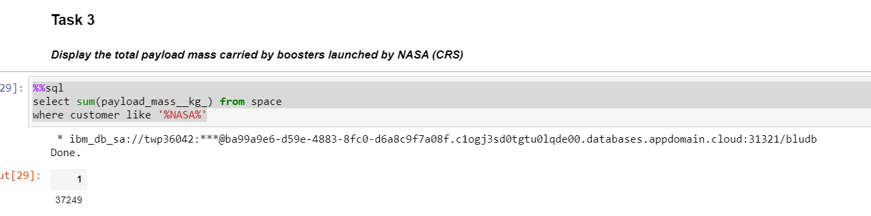
Total Payload Mass
Calculate the total payload carried by boosters from NASA
Present your query result with a short explanation here
The total payload is 37239

Slide 27
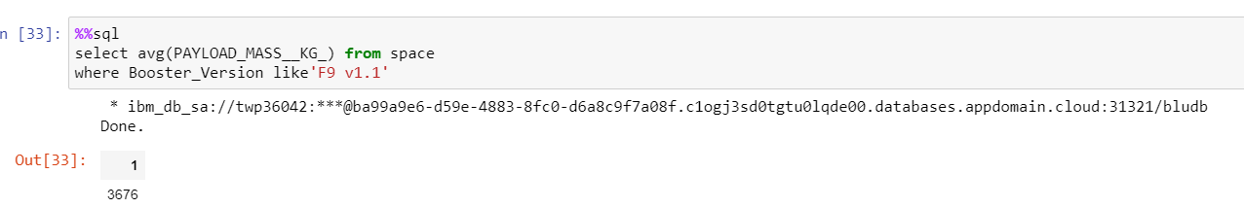
Average Payload Mass by F9 v1.1
Calculate the average payload mass carried by booster version F9 v1.1
Present your query result with a short explanation here
The average of the payload mass carried by booster version F9 v1.1 is 3676

Slide 28
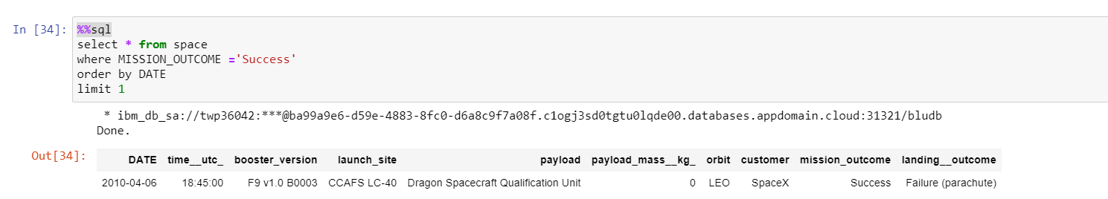
First Successful Ground Landing Date
Find the dates of the first successful landing outcome on ground pad
Present your query result with a short explanation here
Use limit to restrict 1 output

Slide 29
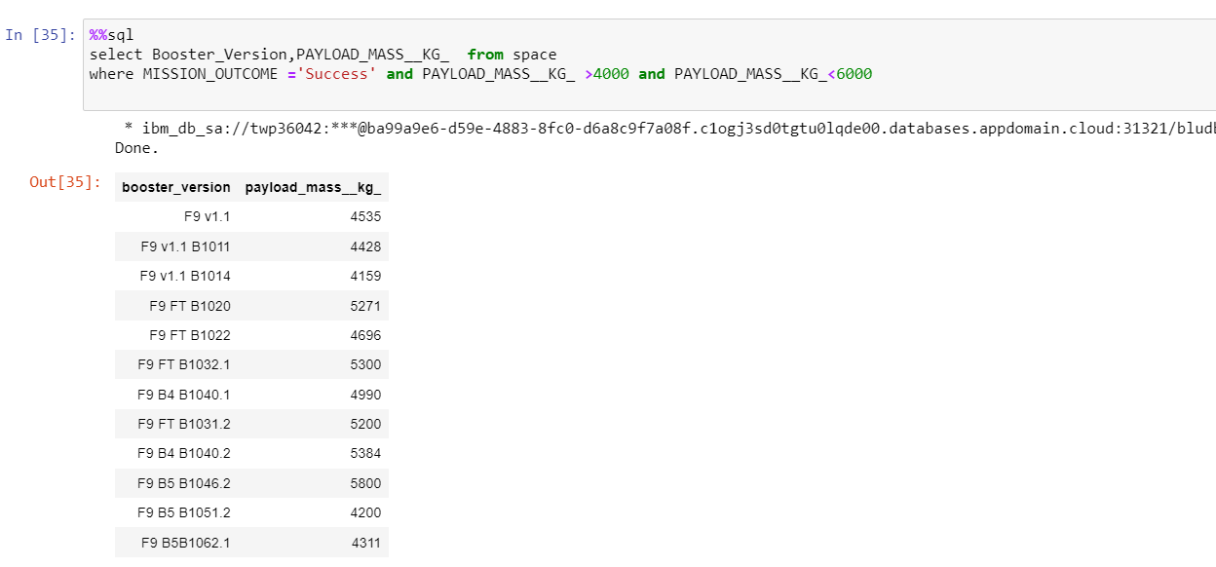
Successful Drone Ship Landing with Payload between 4000 and 6000
List the names of boosters which have successfully landed on drone ship and had payload mass greater than 4000 but less than 6000
A list of boost version with payload mass greater than 4000 but less than 6000

Slide 30
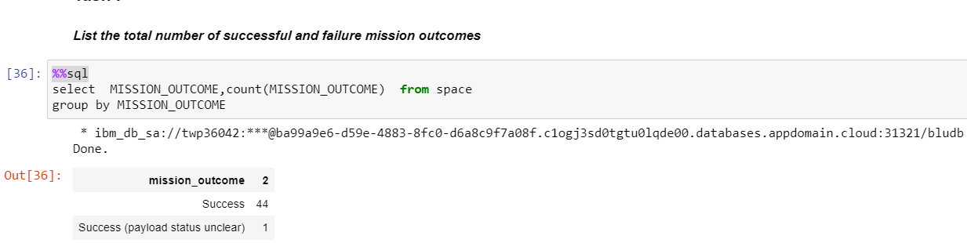
Total Number of Successful and Failure Mission Outcomes
Calculate the total number of successful and failure mission outcomes
Present your query result with a short explanation here
Outputting 44 and 1 with the success and success unclear outcomes

Slide 31
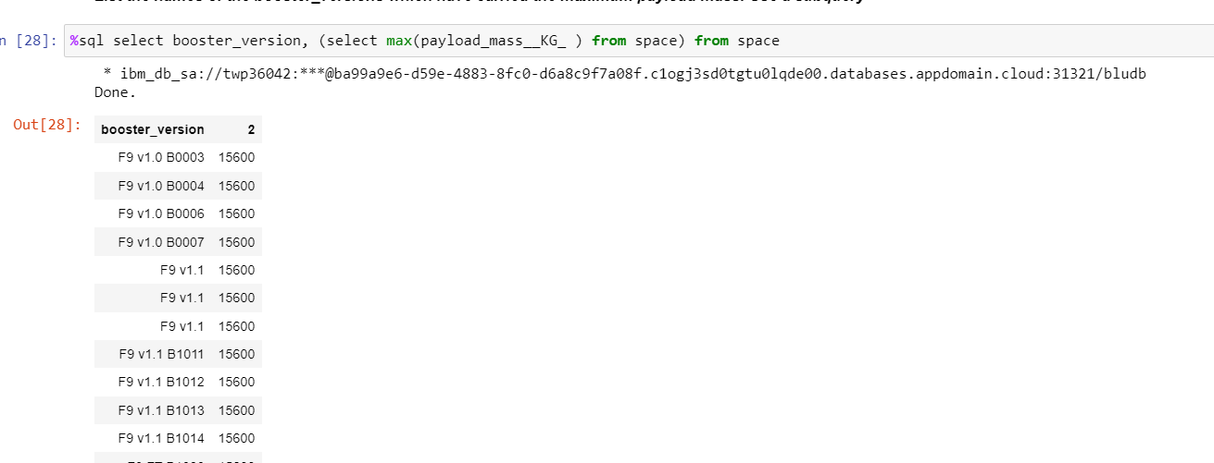
Boosters Carried Maximum Payload
List the names of the booster which have carried the maximum payload mass
Outputting the highest payload mass with booster versions

Slide 32
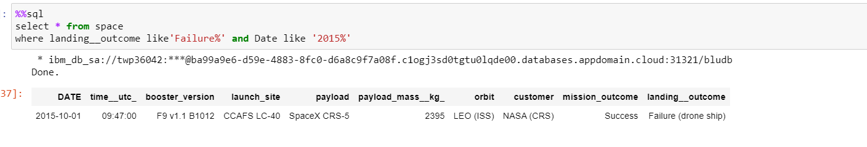
2015 Launch Records
List the failed landing_outcomes in drone ship, their booster versions, and launch site names for in year 2015
Outputting the failure of drone ship

Slide 33
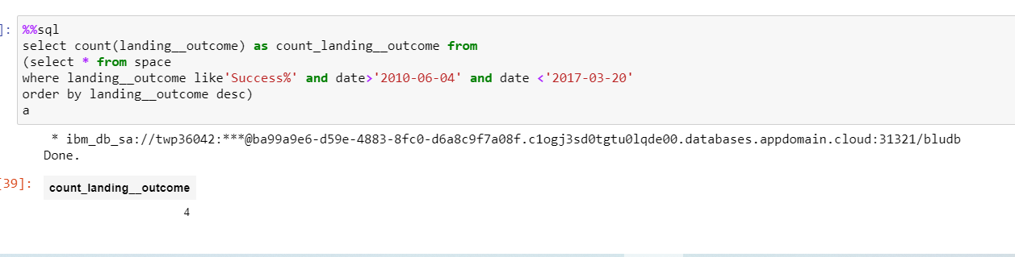
Rank Landing Outcomes Between 2010-06-04 and 2017-03-20
Rank the count of landing outcomes (such as Failure (drone ship) or Success (ground pad)) between the date 2010-06-04 and 2017-03-20, in descending order
4 actual count of the according outcome

Slide 34


Slide 35
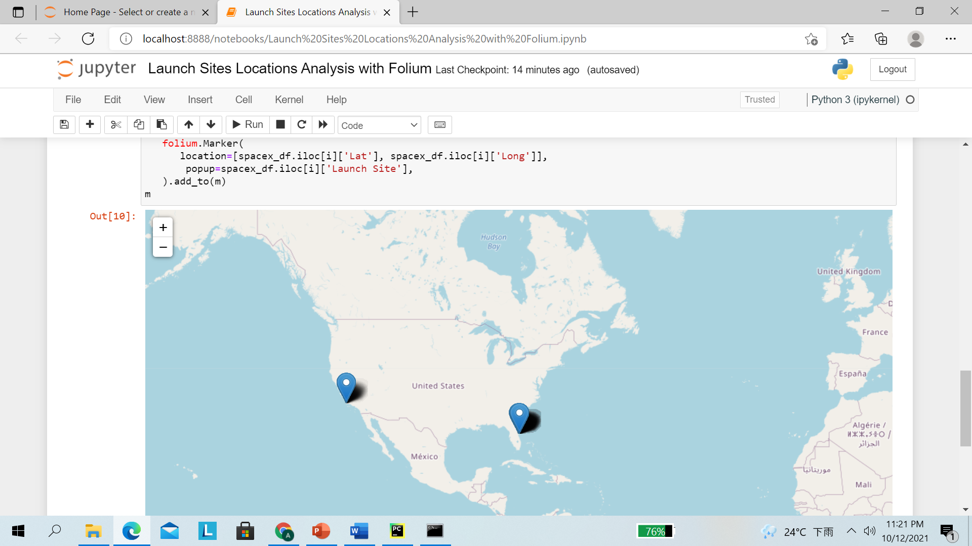
<Folium Map Screenshot 1>
Replace <All Launch sites in global > title with an appropriate title
All launch site in global is packed in USA

Slide 36
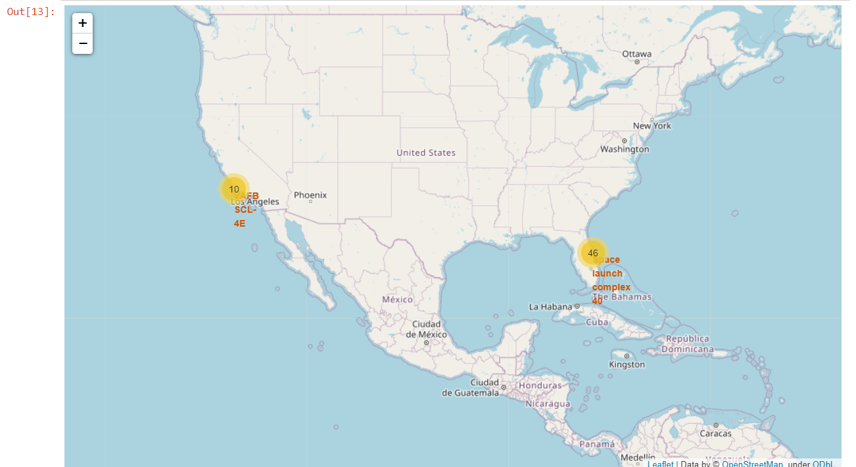
<Folium Map Screenshot 2>
Replace <Color-labeled launch outcomes > title with an appropriate title
The side that near Florida has more launch sites in compare

Slide 37
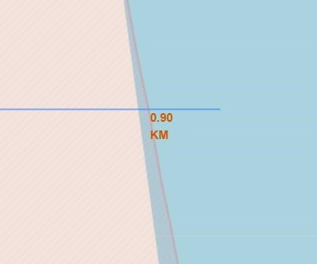
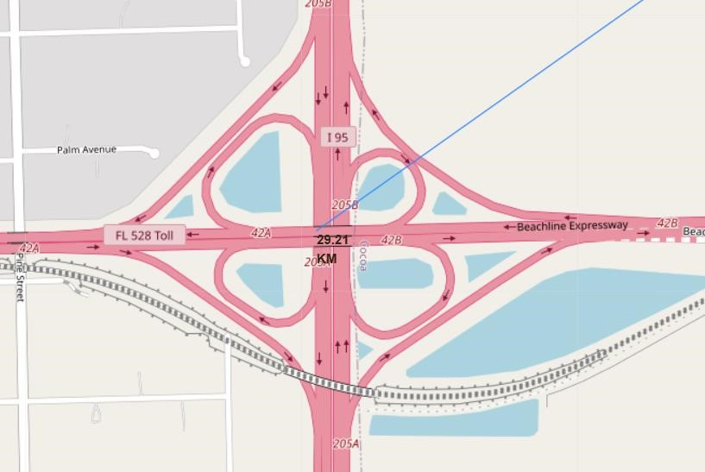
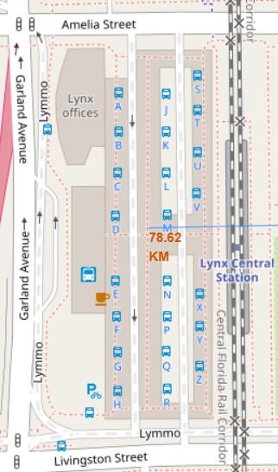
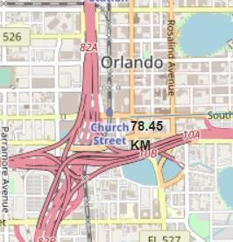
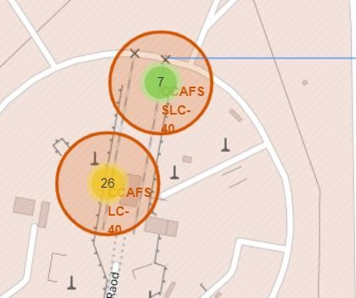
< proximities of railway, highway, and coastline >
Only launch sites is close proximity to coastline. However railways and coastline are not. The launch site in another hand also keep certain distance to the city

Slide 38


Slide 39
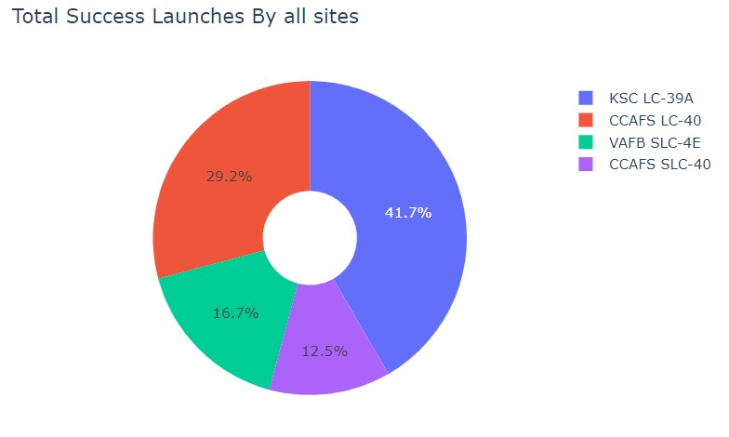
< Success count for all site >
KSC LC_39A has the most success launches by all sites

Slide 40
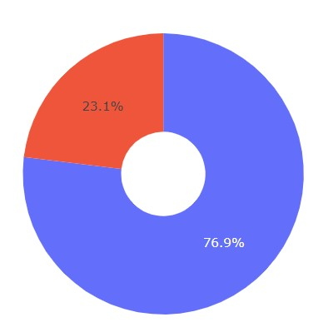
< piechart for the launch site with highest launch success ratio >
KSC LC-39A achieved a 76.9% success rate while getting a 23.1% failure rate

Slide 41
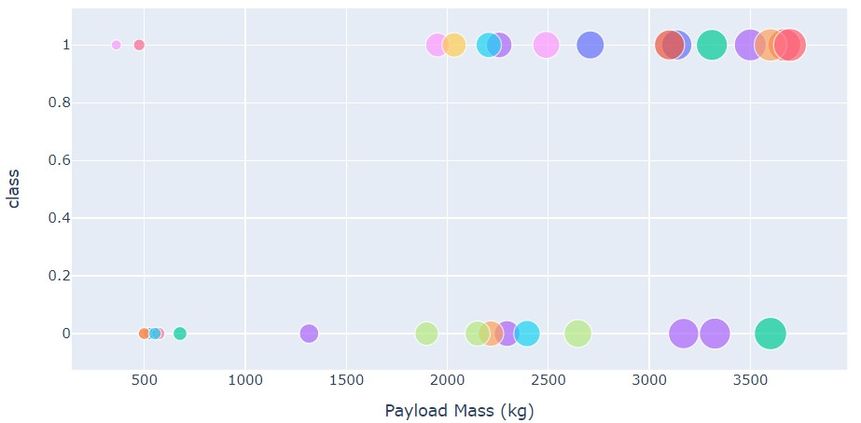
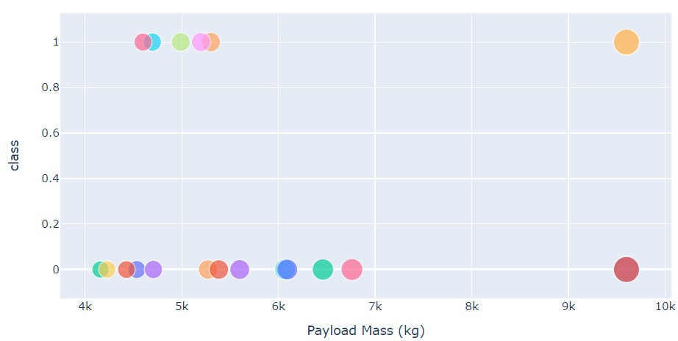
<Payload vs. Launch Outcome scatter plot for all sites, with different payload selected in the range >
Low Weighted Payload 0kg – 4000kg Heavy Weighted Payload 4000kg – 10000kg
We can see the success rates for low weighted payloads is higher than the heavy weighted payloads

Slide 42


Slide 43
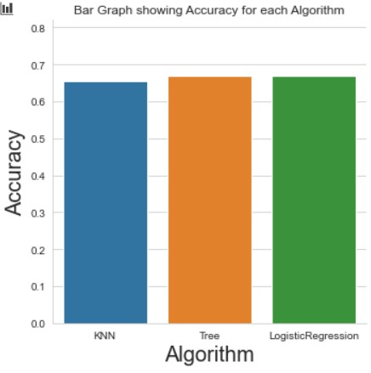
Classification Accuracy
Visualize the built model accuracy for all built classification models, in a bar chart
Tree classification has the highest accuracy

Slide 44
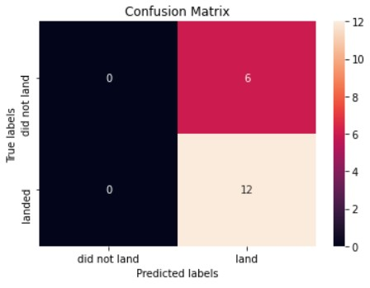
Confusion Matrix
Low weighted payloads perform better than the heavier payloads, which more of the Tp indicates the passing of the indication

Slide 45
Conclusions
The success rates for SpaceX launches is directly proportional time in years
they will eventually perfect the launches
We can see that KSC LC-39A had the most successful launches from all the sites
Orbit GEO,HEO,SSO,ES-L1 has the best Success Rate

Slide 46
Appendix
Include any relevant assets like Python code snippets, SQL queries, charts, Notebook outputs, or data sets that you may have created during this project

Slide 47


